Slide 1
Continental Drift
A Moving Story

Slide 2
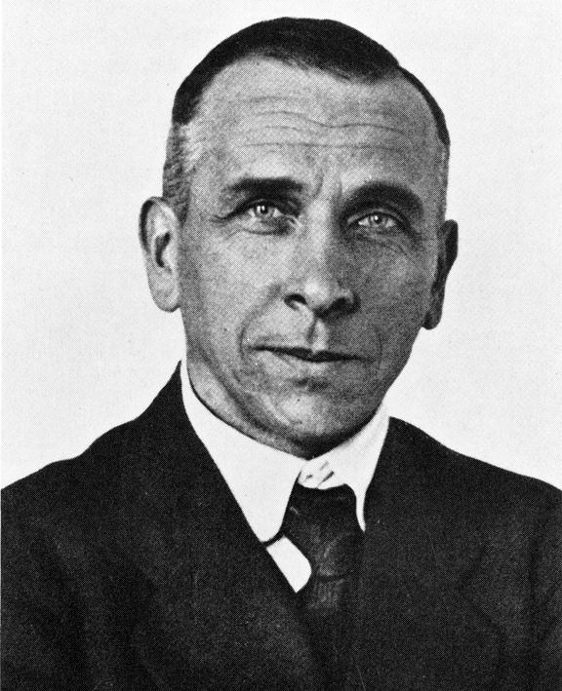
Continental Drift
Alfred Wegener
First suggested continental drift in 1912
Continental drift is a theory of the continents in motion over the Earth’s surface

Slide 3
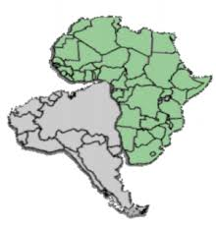
Continental Drift
Wegner used the shapes of matching shorelines of different continents to support continental drift.

Slide 4
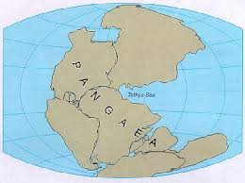
Pangaea – all Earth

Slide 5
Pangaea
One ancient supercontinent of the geologic past that contained all Earth’s land mass about 200 million years ago
Panthalassa
A large ancient ocean that surrounded Pangaea
  Included several smaller seas like Tethys sea near Greece
  Continental Drift

Slide 6
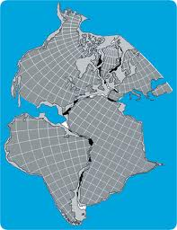
Reverse Engineering
Wegener’s model revealed considerable areas of crustal overlap and large gaps
In the 1960’s Sir Edward Bullard used a computer program to fit the continents together using a depth of 2000 m below sea level because shallow parts of the ocean floor close to shore are underlain by materials similar to those beneath continents.

Slide 7
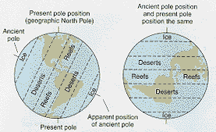
Other Evidence
Rock sequences , types, ages, and structural styles alone coastline edges
Mountain ranges end on one coast and continue on another continent
Glacial deposits in now tropical areas must have been closer to the poles at one time
Glacier movement leaving grooves on different continents

Slide 8
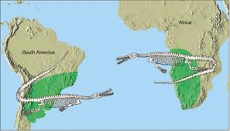
Other Evidence
Fossils, animals that are known to have lived only in one place show fossil evidence across oceans.

Slide 9
Objections to Continental Drift
From 1924 to 1930 drift hypothesis received a lot of hostile criticism and sometimes open ridicule
Wegener’s mechanism of how the continents move were not widely accepted
  Wegener suggested that continents plow through the ocean basin

Slide 10
Objections to Continental Drift
  The leading edges of the continents deformed into mountain ridges because of drag imposed by ocean rocks
  The driving mechanism was a combination of the gravitational attraction of Earth’s equatorial bulge and tidal forces from the Sun and Mood

