Slide 1
PLATE MOTION

Slide 2
Types of Plate Boundaries
Divergent boundaries
Convergent boundaries
Transform boundaries

Slide 3
Divergent Boundaries
Occur when two plates move apart from each other
along the mid-ocean ridge where new seafloor is created due to sea floor spreading
A common feature along the mid-ocean ridge is a central downdropped linear rift valley.

Slide 4
Rift Valley

Slide 5
Divergent Plates
Plates are being continuously pulled apart
Upwelling of magma beneath the mid-ocean ridge is simply filling in the void left by the separating plates
~20 km³ of new crust worldwide is being formed each year
Notes:
rather than being pushed apart by upwelling material beneath the mid-ocean ridge

Slide 6
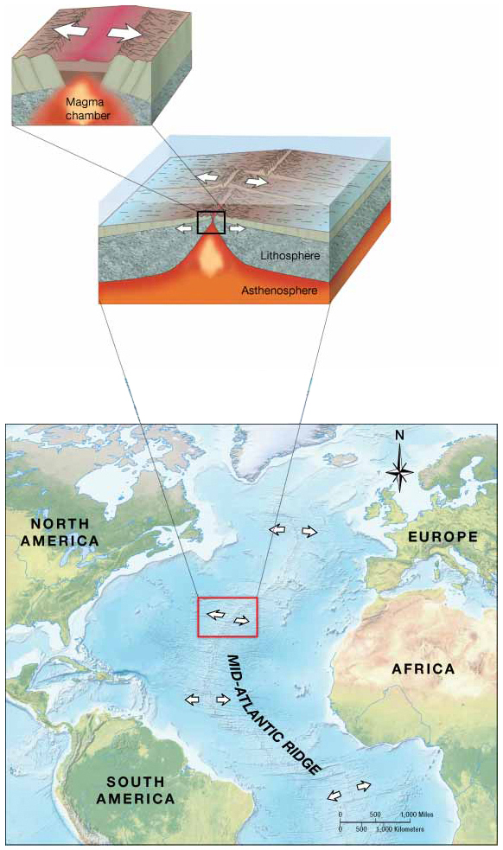
Divergent Plate Boundary

Slide 7
Generation of a Divergent Plate Boundary
Notes:
Molten material rises to the surface causing upwarping and thinning of the crust
Volcanic activity produces vast quantities of high-density basaltic rock.
Plate pull apart forming a rift valley
Further rifting of the land and more spreading causes the area to drop below sea level eventually flooding forming a linear sea.
After millions of years

Slide 8
Types of Spreading Centers
Oceanic rise
Fast-spreading
Gentle slopes
East Pacific
Oceanic ridge
Slow-spreading
Steep slopes
Mid-Atlantic
Ultra-slow
Deep rift valley
Widely scattered volcanoes
Arctic and southwest India
Notes:
There are three types of spreading centers oceanic rise, oceanic ridge, and ultra-slow. These spreading centers are spread out throughout the globe.

Slide 9
Convergent Boundaries
Where two plates move together and collide
Result in the destruction of ocean crust as one plate plunges below the other and is re-melted into the mantle
Features of a convergent boundary
Ocean trench
Volcanic arc
Notes:
Subduction zone causes an arc-shaped row of highly active and explosively erupting volcanoes that parallel the trench called a volcanic arc

Slide 10
Three Types of Convergent Boundaries Oceanic-Continental Convergence Oceanic-Oceanic Convergence Continental-Continental Convergence

Slide 11
Oceanic-Continental Convergence
Ocean plate is subducted
Continental arcs generated
Explosive andesitic volcanic eruptions
Notes:
When an oceanic plate that is more dense collides with the continental plate that is less dense, the denser plate is subducted
Molten basalt rock mixes with superheated gases (mostly water and other volatiles) and begins to rise to the surface through the continental crust
The rising basalt rich magma mixes with the granite of the continental crust producing lava. This chemical composition of lava is called andesite. Contains silica, very dangerous, very explosive type of volcanoes.

Slide 12
Oceanic-Oceanic Convergence
The denser oceanic plate is subducted
Typically the older oceanic plate is denser due to longer time to cool
Produces the deepest trenches in the world
Produces Island arcs
Separated from the nearest continent by a marginal sea
Notes:
Similar to Oceanic-Continental convergence, molten basalt rock mixes with superheated gases (mostly water and other volatiles) and begins to rise to the surface to produce volcanoes. Mostly basalt, no silica, less viscous than andesite

Slide 13
Island Arcs
West Indies’ Leeward and Windward Islands / Puerto Rico Trench in the Caribbean Sea

Slide 14
Island Arcs
Aleutian Islands /Aleutian Trench in the North Pacific Ocean

Slide 15
Continental – Continental Convergence
No subduction – no density difference
Tall uplifted mountain ranges form
Folded and deformed sedimentary rocks originally deposited on the sea floor
Himalayas formed from the collision of the India with Asia plates

Slide 16
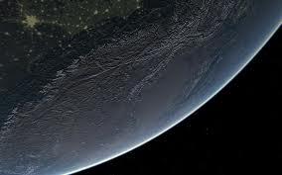
Himalayas
Tallest mountains on the Earth seen from space

Slide 17
Transform Boundaries
Offsets oriented perpendicular to mid-ocean ridge
Segments of plates slide past each other
Offsets permit mid-ocean ridge to move apart at different rates
Shallow but strong earthquakes
Notes:
A global sea floor map shows that the mid-ocean ridge is offset by many large features oriented perpendicular to the crest of the ridge. What causes these offsets? They occur because spreading at a mid-ocean ridge only occurs perpendicular to the axis of a ridge and all parts of a plate must move together. As a result, offsets are oriented perpendicular to the ridge and parallel to each other to accommodate spreading of the linear ridge system on a spherical Earth.

Slide 18
Transform Boundary Features
Oceanic Transform Fault – ocean floor only
Continental Transform Fault – cuts across continent
San Andreas Fault
Transform faults occur between mid-ocean ridge segments.

Slide 19
Applications of Plate Tectonics
Mantle Plumes and Hotspots
Intraplate features
Volcanic islands within a plate
Island chains
Record ancient plate motions
Nematath – hotspot track
Notes:
Plate tectonics helped explain the origin of many features near plate boundaries, it did not seem to explain the origin of intraplate features that are far from any plate boundary.

Slide 20
Global Hotspots Locations
Notes:
Hotspots are where mantle plumes come to the surface are called hotspots and are marked by an abundance of volcanic activity.
Ex: Yellowstone National Park and Hawaii

Slide 21
Hawaiian Island – Emperor Seamount Nematath

Slide 22
Plate Tectonics and Intraplate Features
Seamounts
Rounded tops
Tablemounts or guyots
Flattened tops
Subsidence of flanks of mid-ocean ridge
Wave erosion may flatten seamount.

Slide 23
Plate Tectonics and Intraplate Features

